Slide 1

MiniProject 3
Evan Ezell

Slide 2

Simple Questions
Time to take entire survey?
Question that took the longest to complete?
Question that took the least time?
Top-ranked criteria?
Demographic distribution by age?

Slide 3
Time to take entire survey?
There were 21 cases where the survey took over 30 min, some taking multiple hours. I filtered these out since it is unlikely that someone actually took the survey for that long.

Slide 5
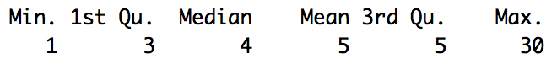
Most people took less than 5 minutes (55%) to take the survey.

Slide 6
Question that took the longest to complete?
Again, I filtered the data based on people that took less than 30 minutes to complete the survey. On the next page are the histograms of each question.

Slide 8
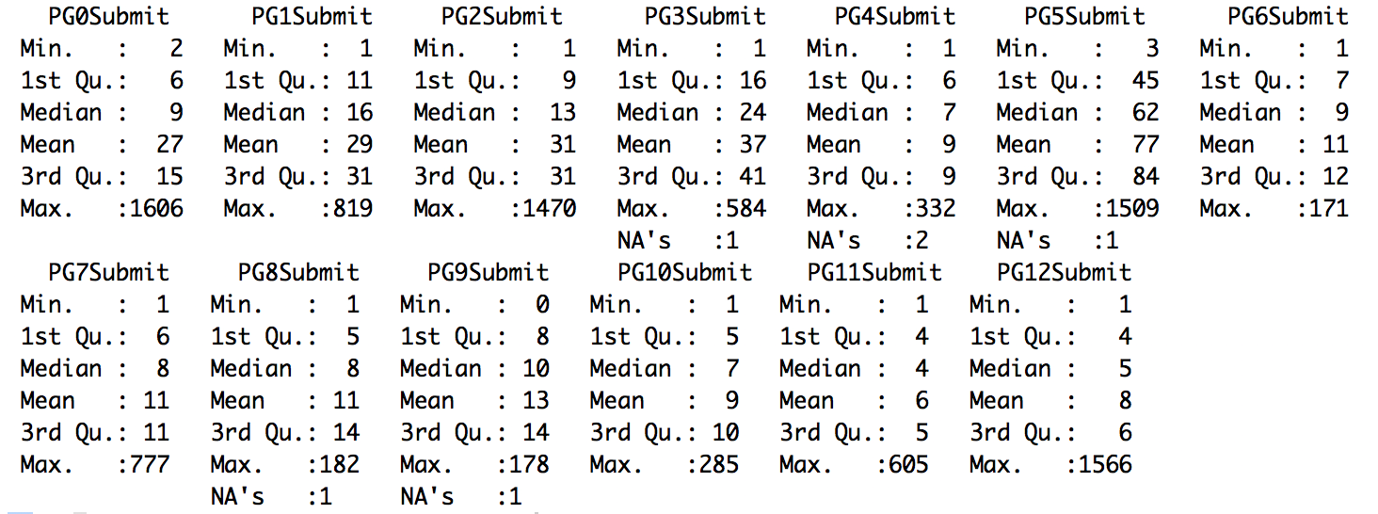
Question 5 took the longest to complete. This should not be a surprise since it was very involved.

Slide 9

Question that took the least time?
Using the median as a metric since the distribution of time is highly skewed, we can see that Question 11 took the least time to submit. Refer to the output in previous two slides.

Slide 10
Top-ranked criteria?

Slide 11
Demographic distribution by age?

Slide 12

Survey Improvements
The response for Question 5 does not show the priority level of each category. It only shows one priority level. It would be helpful to collect the priority level of each category.
The response metrics for questions with the option “other” is confusing. If the user selects a categorized check box and also inputs other, the response for other is submitted in place of the categorized check box string
The order variable for page 5 allows for multiple orderings (i.e. order values greater than the number of categories). Only allow user to place one category in each bin.

Slide 13
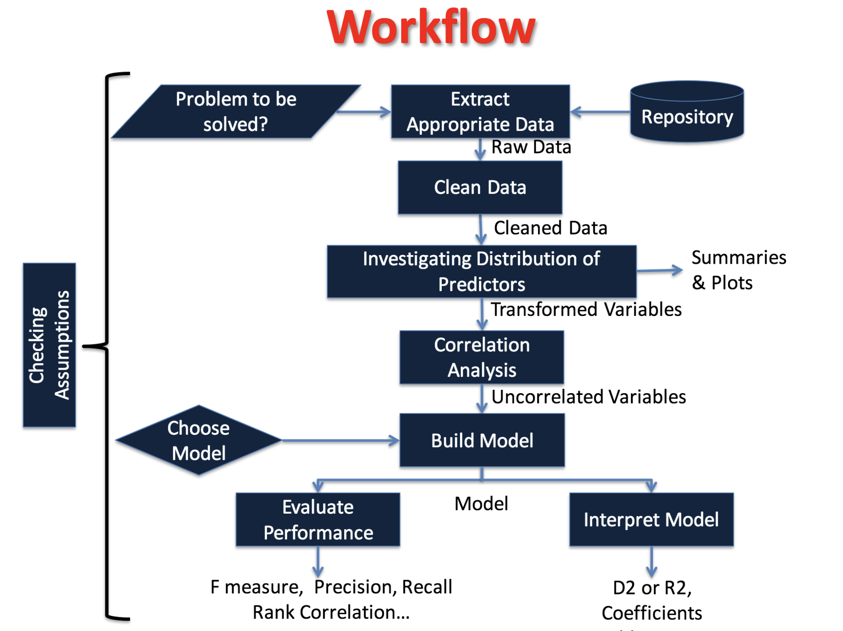
Data Analysis
I tried to follow the workflow on the data analysis lecture by Dr. Audris Mockus.

Slide 14
Problem to be solved?
Can we effectively model a package’s historic reputation?
What does the model tell us about a package’s historic reputation?

Slide 15
Extract appropriate data
I extracted the data using the R read.csv function

Slide 16
Clean Data
I removed the response variables that I was not modeling.
Removed start and end and calculated a total time variable.
Convert Device to dummy variable (1 – PC, 0 – Phone or Tablet, NA – unknown)
Calculated time to submit each response
Calculated time when category selected for Question 5
Convert Completed to 1 or 0, true/false respectively
Changed Page 1 response variables to 1 or 0, true/false respectively

Slide 17
Clean Data
Changed Page 2 response to 1 or 0, Yes/No respectively. Moved not sure to a new variable.
Changed PG2Resp.1 to a series of 5 binary variables representing the different responses
Changed PG5_5PHR to numerical class labels 0 - 4, “Not a priority” -> “Essential” respectively
Created binary PG5_5PHR_bin from PG5_5PHR. Essential and High Priority were set to 1, all others to 0.
Changed PG6Resp into an ordinal variable

Slide 18
Clean Data
Changed all of PG7[Language] variables into binary variables
Changed PG8Resp into 5 variables that represented all the responses: Software Engineer, Data Scientist, Teacher/Professor, Student, Researcher, Professional
Changed PG9Resp into an ordinal variable
Split PG10 into two variables: PG10Resp_native (binary variable native/not-native) and PG10Resp into ordinal language proficiency variable
Changed PG11Resp into binary variable for male/female
Changed PG12Resp into ordinal variable

Slide 19
Removing entries
Cases where there was no response variable
Cases where survey was not completed
Cases where survey took more than 30 minutes to complete
This eliminated 771/1352 ≅ 57% cases

Slide 20
Selecting Predictors
No reason to believe time spent on other questions affects participants ranking of how important the package’s historic reputation is. I remove all time variables except total time for survey and time spend on question 5.
PG0Dis and PG0Shown appears to be unreliable. I removed them.
Device should not influence response of PHR. I removed it.
Remove extra PG4 variables

Slide 21
Investigating Distribution of Predictors
I did not include the summary output here since there were so many predictors (78).
From the summary, I noticed the time variables are skewed right so I log-transformed them
All other variables were ordinal or binary so it was not necessary to transform them

Slide 22
Before/After Transform for Total Survey Time
Transform did a relatively good job of eliminating heteroscedasticity

Slide 23
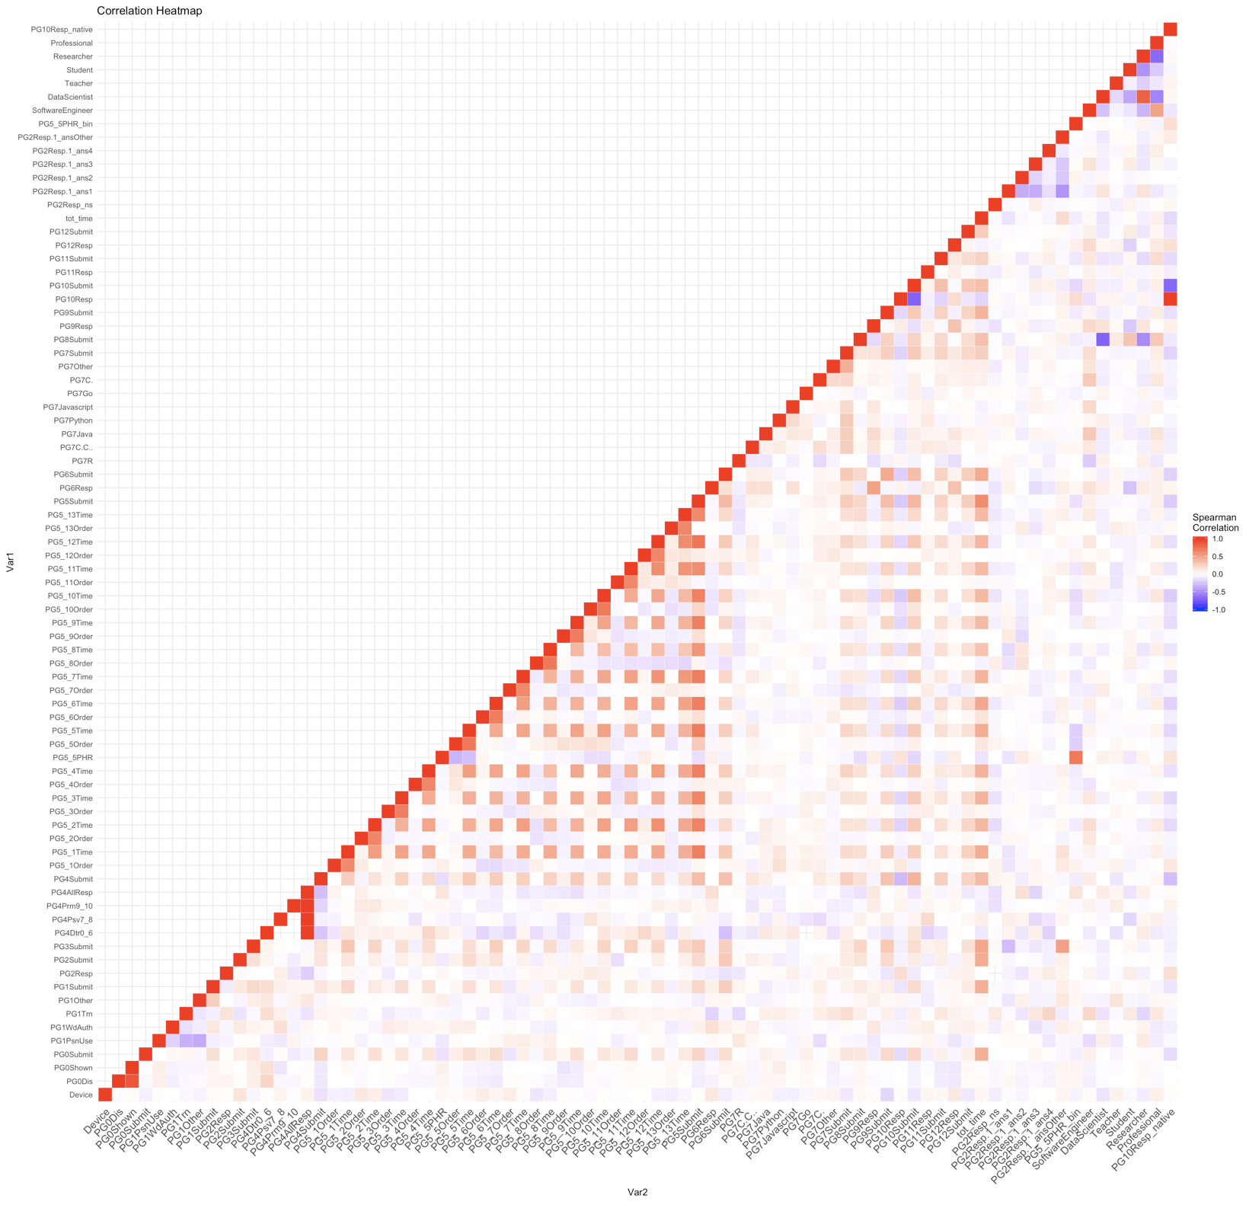
Correlation Analysis

Slide 24
Breakdown of Response Variable

Slide 25
Model
I chose to run a logistic regression model modeling the binary variable PG5PHR_bin.
The output is on the next slide

Slide 26
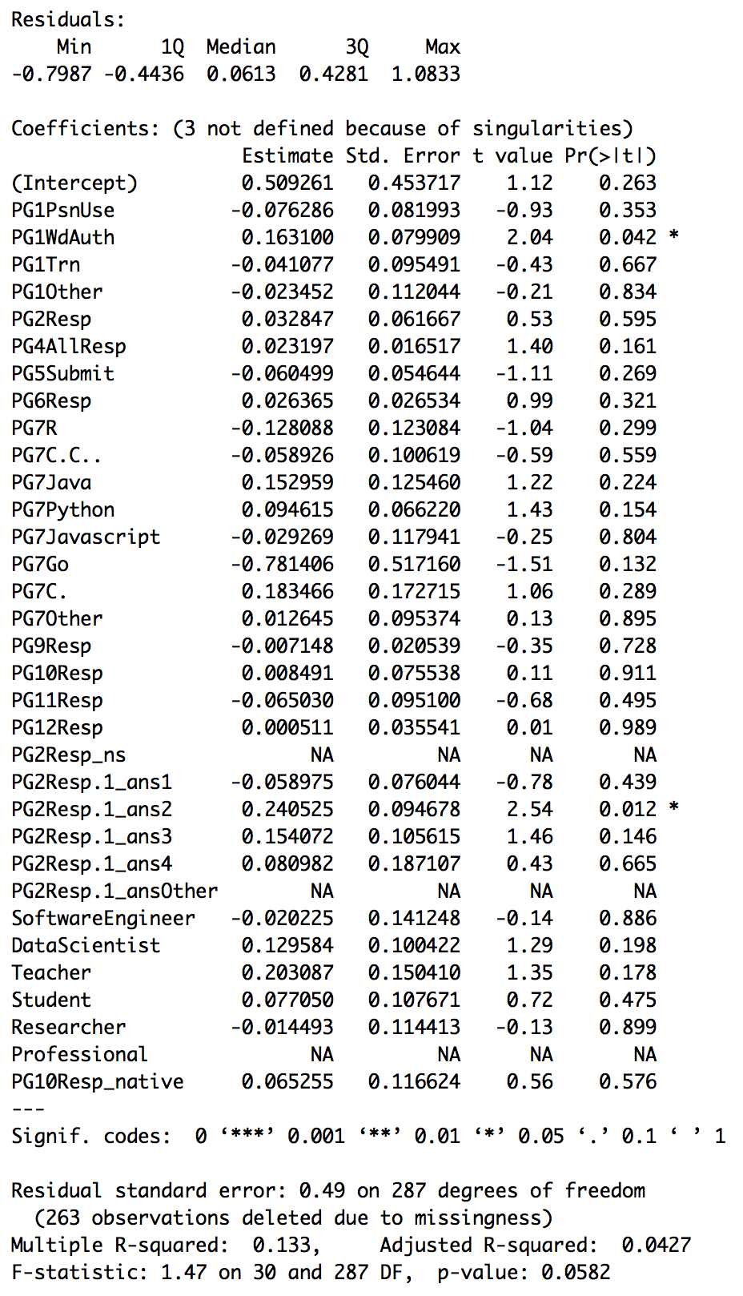

Slide 27
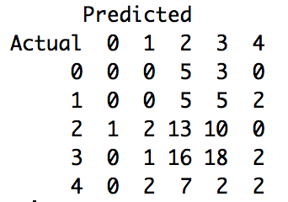
kNN
I also tried a kNN classification model. Here are the results for the response PG5PHR.

Slide 28
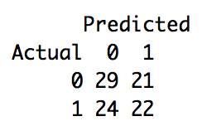
kNN
I also tried a kNN classification model. Here are the results for the response PG5PHR_bin.

Slide 29
Issues
As you can see the adjR^2 is extremely low
I tried to drop different terms and could not achieve much better results
How important the package’s historic reputation is extremely hard to predict given the current survey data. I cannot think of a single predictor we were given that would intuitively explain this response.
There is not many respondents with missing data. When you remove rows with NAs there are only about 300 rows. Some imputation strategy might be necessary.
When taking out NAs there were only a limited number of responses that were “Not a priority” or “low priority”

